Slide 1
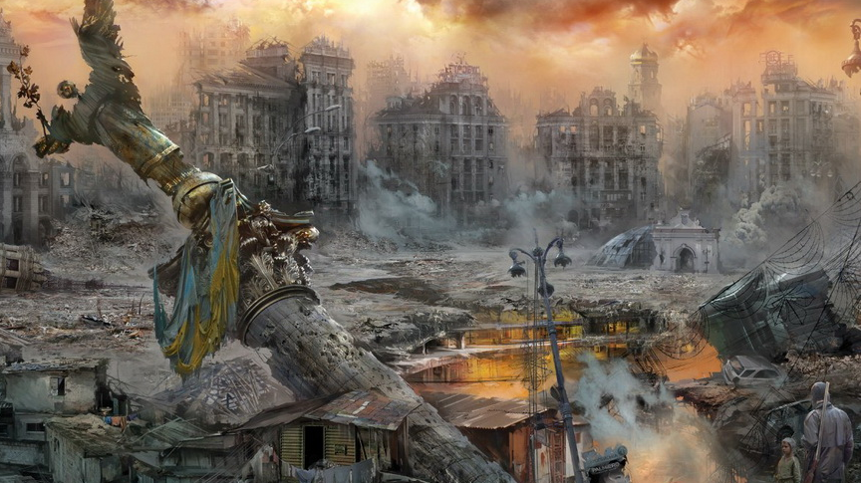
Postapocalyptic - rts
Europe? Maybe map dependent

Slide 2
Entity
Unit
Settler
Cattle
Animated
Turret
Resource
Junk
Shed
Kitchen
Wall
Building
Water
Brahmin
Radstag
Monster
Radroach
Molerat
Guard Tower
WorkBuilding
Storage

Slide 3
Entity
Unit
Settler
Kitchen
Building
askAssignToBuilding
AskAssingToBuildin
StartAssignmentAssign
EndCurrentAssignment
EndCurrentAssignment
Accepted
StartAssignment
Refused
EndAssignment
Trigger
Callback
Method

Slide 4
Resource management
Auto finding of drop-off points
Gathering
Carrying
Delivering

